Slide 1
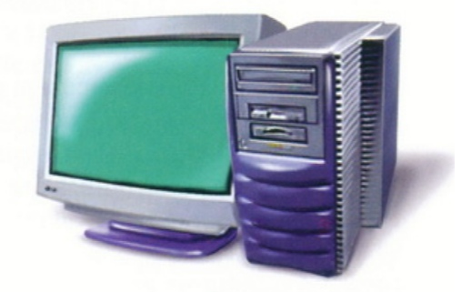
Workstations
Prepared by Pavel Zhukovski (13 group)

Slide 2
For whom are they designed:
Small engineering companies
Architects
Graphic designers
Others

Slide 3
The most successful makers of this kind of workstation
Sun Microsystems
Hewlett-Packard
DEC
IBM

Slide 4
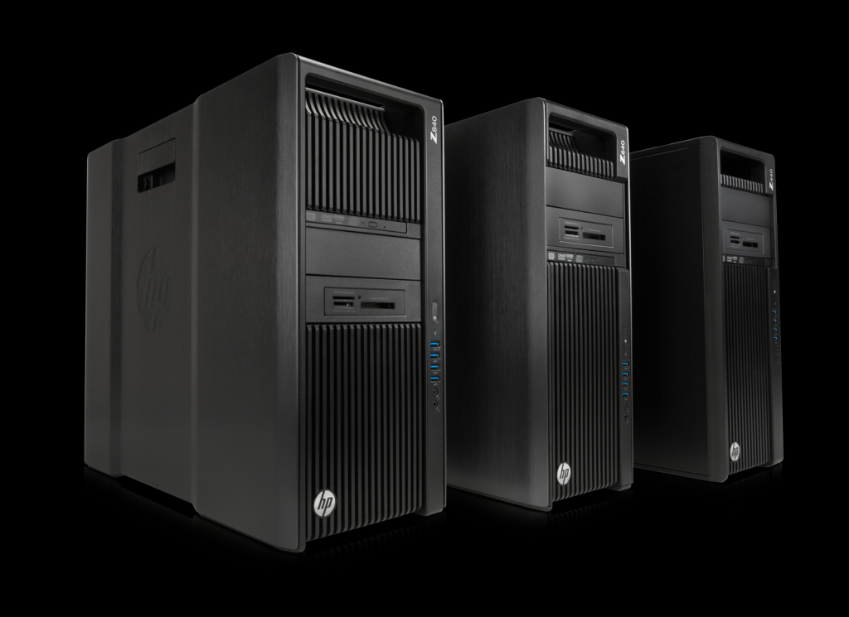
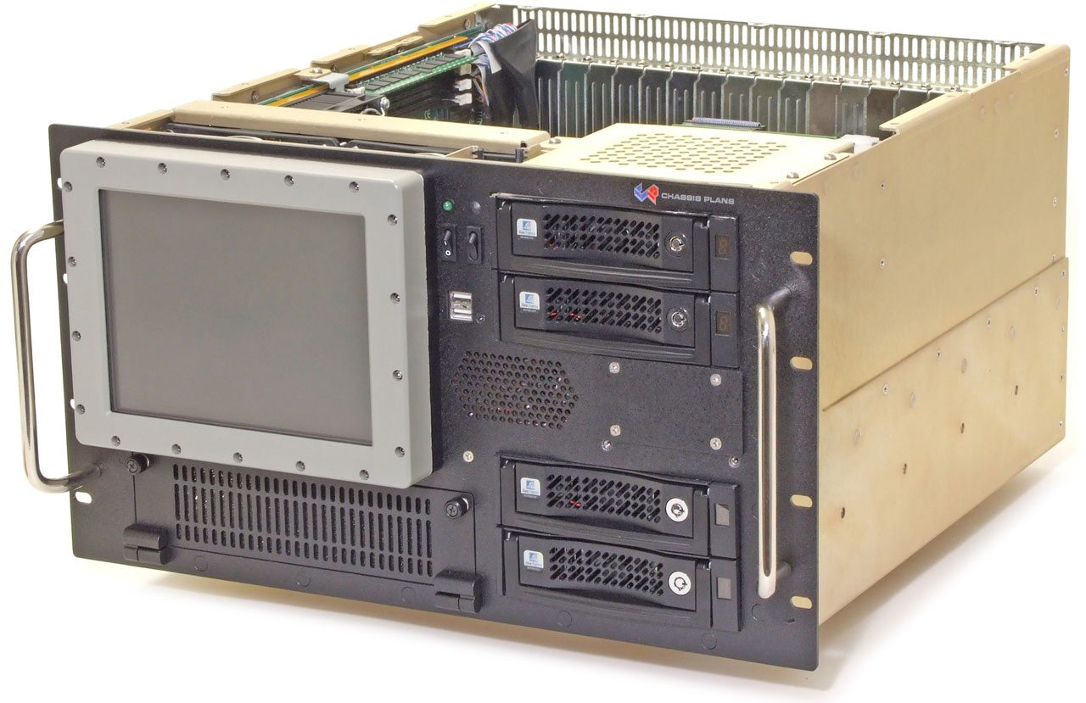
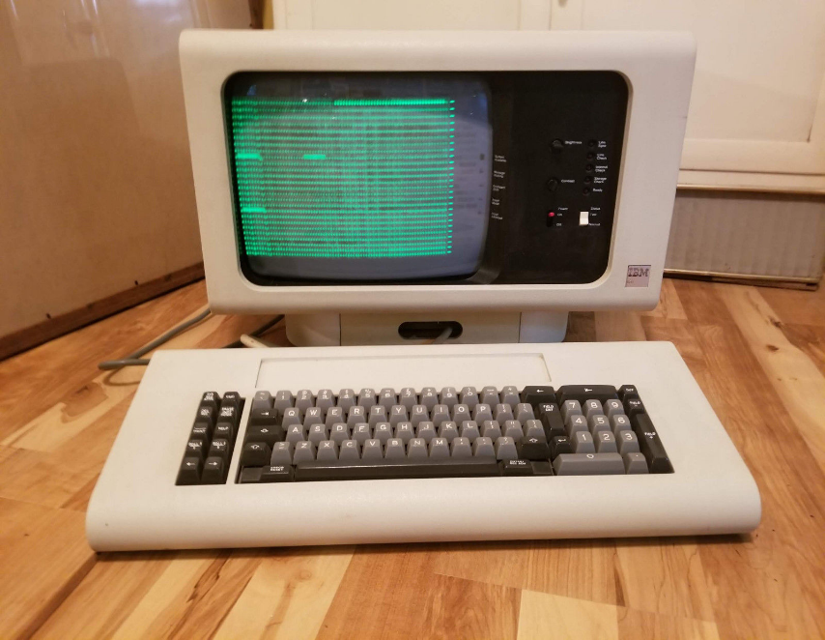
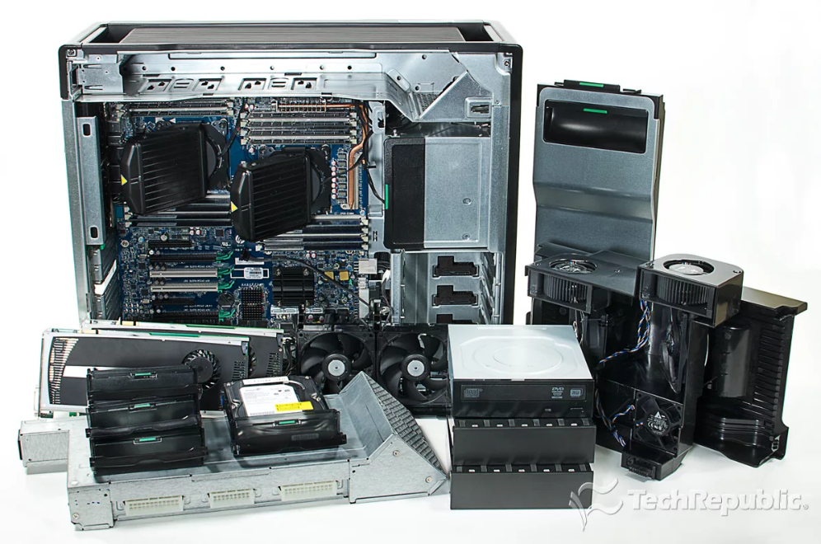
Examples of workstations

Slide 5

Top 4 workstations 2018 (film)

Slide 6
The end
Thanks for attention!

